Slide 1
LO GO
The Battle of Neighborhoods
www.isl ide.cc
Designed by iSl ide 内容来源于网络

Slide 2
Introduction
New York City's is a large and ethnically diverse metropolis. It is the largest city in the United States with a long history of international immigration. New York City was home to nearly 8.5 million people in 2014, accounting for over 40% of the population of New York State and a slightly lower percentage of the New York metropolitan area, home to approximately 23.6 million. Over the last decade the city has been growing faster than the region. The New York region continues to be by far the leading metropolitan gateway for legal immigrants admitted into the United States.
With its diverse culture, comes diverse food items. There are many restaurants in New York City, each belonging to different categories like Chinese, Indian, and French etc.

Slide 3
Problems
1. What are best location in New York City for Chinese restaurant?
2. Which areas have potential Chinese restaurant market?
3. Which all areas lack Chinese restaurants?
4. Which is the best Chinese restaurant in New York City?

Slide 4
Data Section
• New York City data that contains list Boroughs, Neighborhoods along with their latitude and longitude.
Data source : https://cocl.us/new_york_dataset
Description: This data set contains the required information. And we will use this data set to explore various neighbourhoods of New York City
• Chinese restaurants in each neighborhood of New York City.
Data source : Foursquare API
Description: By using this API we will get all the venues in each neighborhood. We can filter these venues to get only Chinese restaurants.
• GeoSpace data
Data source : https://data.cityofnewyork.us/City-Government/Borough-Boundaries/tqmj-j8zm
Description: By using this geo space data we will get the New York Borough boundaries that will help us visualize choropleth map.

Slide 5
Methodology
1.We begin by collecting the New York city data from the following link "https://cocl.us/new York dataset"
2.We will find all venues for each neighborhoods using Foursquare API
3.We will then filter out all venues with Chinese restaurant for further analysis.
4.Next using Foursquare API, we will find the Ratings, Tips, and Number of Likes for all the Chinese Restaurants.
5.We will then sort Neighborhood's and Borough the data keeping Ratings as the constraint.
6.Next we will consider the neighborhoods with top 20 rating to visualize on map.
7.We will join this dataset to original New York data to get longitude and latitude.
8.Finally, we will visualize the Neighborhoods and Borough based on average

Slide 6
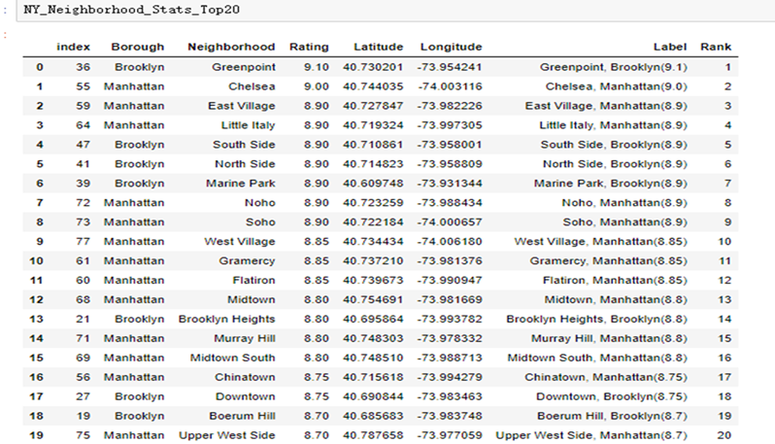
Conclusion
1.The following locations are the top 20 neighborhoods for Chinese restaurant

Slide 7
Conclusion
2.Greenpoint (Brooklyn), Chelsea (Manhattan), East Village (Manhattan) are some of the best neighborhoods for Chinese cuisine.
3.Manhattan have potential Chinese Restaurant Market.
4.Bronx ranks last in average rating of Chinese Restaurants.
5.Xi'an Famous Foods in Greenpoint, Brooklyn is the best Chinese restaurant in New York City.

